Slide 1
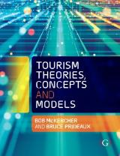

Chapter 13: Impacts – Conflict over Place Change

Slide 2
Learning Objectives
Describe Doxey’s Irridex
Analyse how impacts are caused by place change
Evaluate Budowksi’s relationships between tourism and the environment
Understand how conflict theory underlies early attempts to assess social and environmental impacts of tourism.

Slide 3
Different approaches to impact studies
Equity Theory | Assesses perceived costs vs. benefits Tourism is seen as beneficial when positive and negative consequences are in balance or when the positive aspects outweigh the negative
Growth Machine Theory | Certain stakeholders (those who seek to gain) will support growth in order to maximize their personal economic returns Others may not support growth or may actively oppose it
Lifecycle Theory | Attitudes change as tourism evolves through its lifecycle
Power Theory | Personal power, based on property, money, skills, knowledge and competence, affects one’s ability to exploit exchanges No power residents were more favorable toward tourism development than those with power
Social Exchange theory | Voluntary actions that are motivated by expected returns Individuals or groups will engage in an exchange if they value that which is being exchanged and that the exchange will be rewarding Residents will engage in exchanges with tourists, as long as they “profit” or as long as benefits exceed costs
Stakeholder Theory | As key stakeholders in tourism, residents need to be identified, included and satisfied
Sustainability | Triple bottom line of social, economic and ecological impacts
Dependency Theory | Applicable mostly to developing countries where dependency originates from and, eventually, reinforces unequal power relationships between wealthy countries and poor countries
Social Impact Theory | The consequences to human populations of any public or private actions that alter the way in which people live, work, relate to one another or cope.

Slide 4
Prof Geoffrey Wall talks about tourism impacts and planning
https://www.youtube.com/watch?v=GM0TlF9jTSI

Slide 5
Impacts often framed within a conflict paradigm
Conflict is goal interference attributed to another’s behavior
  Goals are preferred social, psychological or physical outcomes of a behaviour that provide incentives for that behaviour
Conflict may exist at two levels:
  Direct, where the actions of others affect one’s enjoyment; and
  Indirect, where a general and more pervasive feeling of dislike or an unwillingness to appreciate others’ views exist
Likelihood enhanced when a perception exists that people must fight over a fixed-pie asset, which produces winners and losers
Likely to occur when the perceived power balance between stakeholders shifts, empowering one and disempowering the other
Tourism is ideally suited to become a conflict inducer for it often represents a powerful, new stakeholder with different values to existing stakeholders
Conflict is dynamic, evolutionary or revolutionary in style and rarely if ever permanent

Slide 6
Doxey’s Irridex
Stage | Conditions | Impact and resolution
Euphoria | Associated with the initial stages of development | Visitors and investors are welcome Usually little planning and few control mechanisms
Apathy | Visitor numbers increase Tourists taken for granted | Contact begins to become more formal Most planning will be concerned with marketing
Irritation | Saturation point is approached | Residents begin to show misgivings about the tourist industry Policy makers increase infrastructure rather than setting limits to growth
Antagonism | Tourism overwhelms places Saturation point exceeded Reputation of the destination suffers | Irritation overtly expressed verbally and physically Mutual politeness gives way to mutual antagonism Outsiders seen as the cause of all problems Remedial planning and marketing to address issues and generate new business

Slide 7
Is there an unrecognised 5th stage to Doxey?
Conflict is rarely an end state
Communities adjust to tourism as it becomes part of its social, cultural and economic fabric
People modify their behaviours to cope with the annoying aspects of tourism, but they begin also to appreciate what it means to the community in terms of improved livelihood, increased leisure and recreation opportunities, more and better shopping and dining opportunities and a range of other possible benefits

Slide 8
Budowksi – coexistence, symbiosis, conflict
Human use of natural or near natural areas exerts a range of impacts
Tourism, through the introduction of non-traditional activities, uses and/or user groups is no different
Three possible relationships between tourism and natural environments
  Coexistence during the early stages when the tourism industry and those promoting conservation have relatively little contact.
    Transitory state
  Symbiosis in which tourism and conservation derive mutual benefits from each other.
    Also a transitory state
  Conflict most likely end state when the presence of tourism is detrimental to the needs of nature.

Slide 9
Conflicting views over how to manage natural areas
Anthropocentric
Biocentric
Main goal is for the use and enjoyment opportunities these areas provide.
Programs should be developed to encourage and facilitate direct use of natural areas.
View wilderness from a sociological, human oriented perspective.
Naturalness of wilderness is less important that its direct use benefits.
Advocate the philosophy that unhindered operation of natural ecological processes is the fundamental goal of any natural area.
While human use can occur, it must only do so in a manner that is subservient to the natural ecosystem’s needs.

Slide 10
An alternative explanation – impacts as a function of place change
The social meaning people give to geographic space transform it into place and give it meaning
Sense of place is defined by
  Place identity - dimensions of self that define the individual’s personal identity through a complex pattern of conscious and unconscious ideas, beliefs, preferences, feelings, values, goals and behavioural tendencies
  Place dependence - the strength of the association between an individual and a specific place
  Place attachment - positive bond between groups or individuals and their environment.
Reflected by perceptions of insidedness / outsideness and legitimacy of occupation

Slide 11
Destinations consist of 3 types of place
Tourism place - signed and signaled as being for tourists
Non-tourism place - part of the community that is signed and signaled for use by local residents only
Shared place – signed and signaled as being accessible to both
Normally, the relationship between these three types of place evolves toward some form of equilibrium, or coexistence, where each is well defined and both locals and tourists respect their boundaries.

Slide 12
Prof Allison Gill talks about how tourism transforms places
https://www.youtube.com/watch?v=aPp-BaL8ong

Slide 13
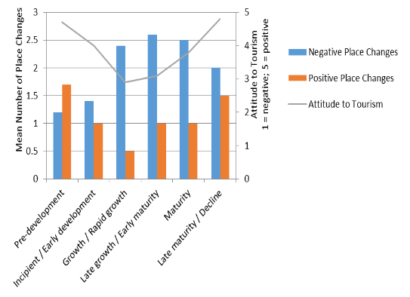
Conflict occurs when place changes
Impacts of tourism are most likely to occur when otherwise stable systems are disrupted.
  Non or shared tourism space becomes exclusive tourism space to the detriment of local residents.
Social disruption theory states that communities experiencing rapid growth typically enter a period of generalized crisis that may lead to a wide array of social problems as changes penetrate throughout communities and at individual levels.
Perceived quality of life may decline initially, but will eventually stabilise and then improve.

